Slide 1
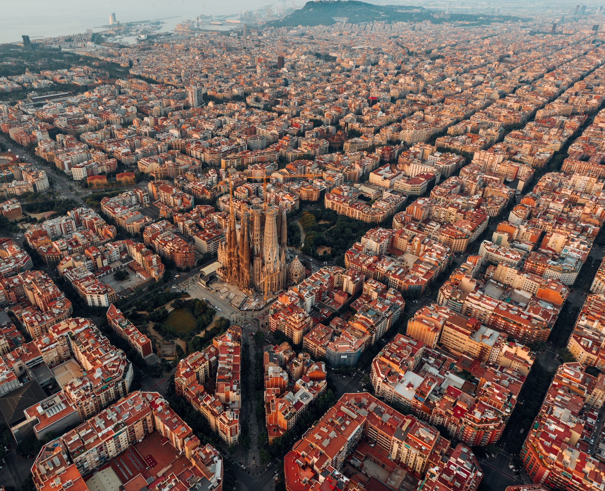

Storage Providers for Durable Functions
2022
The Good, the Bad and the Ugly
17/09/2022

Slide 2






About me
Luis Mañez
Chief Architect @ ClearPeople
M365 Development MVP. More than 20 years of experience working with Microsoft Technologies. MS Certified specialist in Developing Azure and SharePoint MCPD. Passionate about technology, blogger, technical writer and MS community active member.
@luismanez

Slide 4
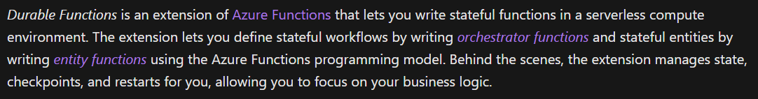

Slide 6


Slide 7


Slide 8


Slide 9

BUT
WHY?

Slide 10







Durable Functions Real-World Architecture
SyncItem 1
SyncItem 2
GetDataToSync
CleanUp
Notifications / Analytics
SyncItem 3
.
.
.
SyncItem N

Slide 11
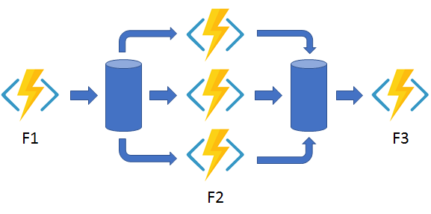
Durable Functions Fan out/fan in Pattern
https://docs.microsoft.com/en-us/azure/azure-functions/durable/durable-functions-overview?tabs=csharp#fan-in-out

Slide 12




Azure Storage
MS SQL Server
Netherite

Slide 13
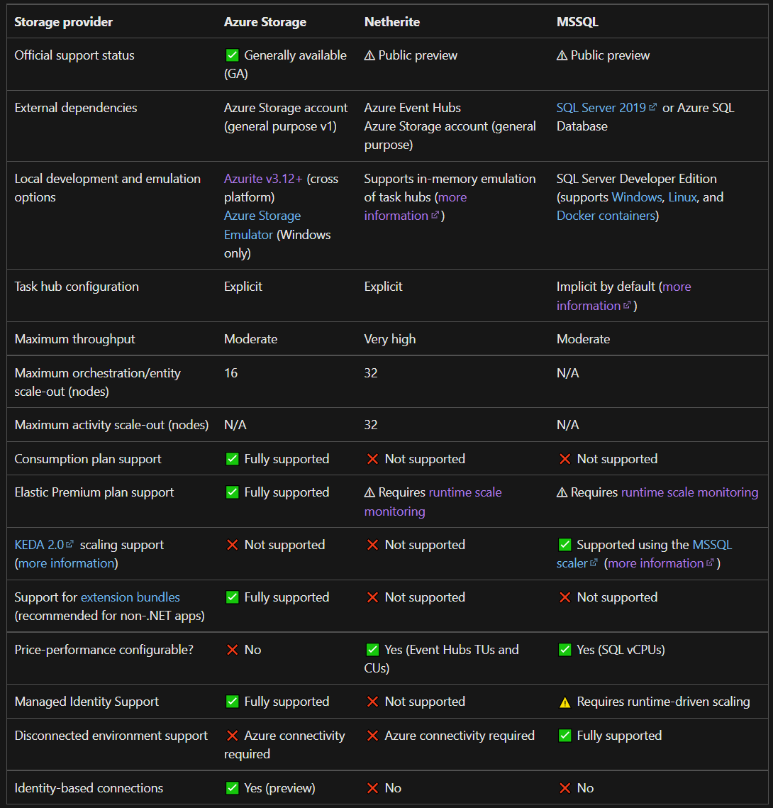
https://docs.microsoft.com/en-us/azure/azure-functions/durable/durable-functions-storage-providers#comparing-storage-providers

Slide 14

Let´s dive in!
Durable Function with Azure Storage Provider

Slide 15
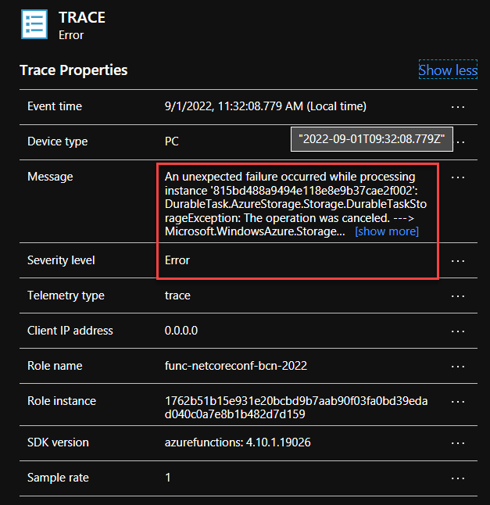
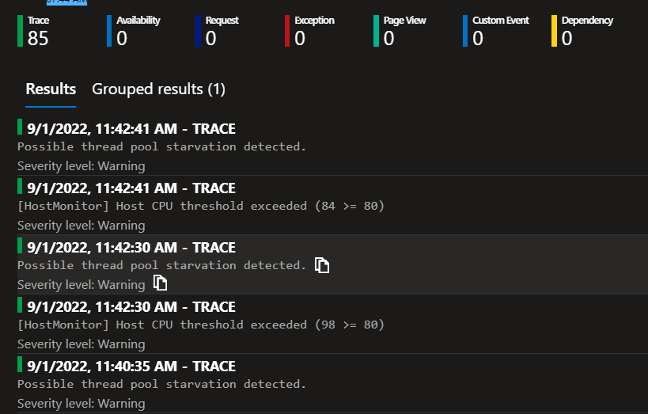
Azure Storage - Processing 30k items (Azure App Service P1V2)

Slide 16
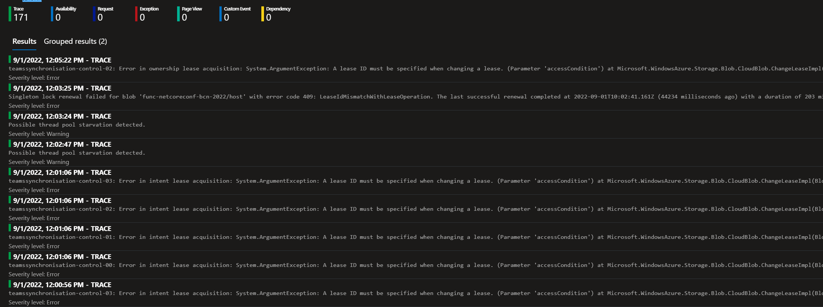

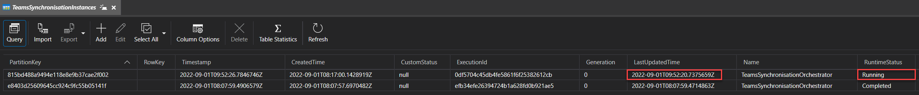
Orchestrator Stuck!!
Current Date Time: 2022-09-01T12:16Z (more than 2h stuck)

Slide 17
Let´s dive in!
Durable Function with SQL Server Storage Provider

Slide 18
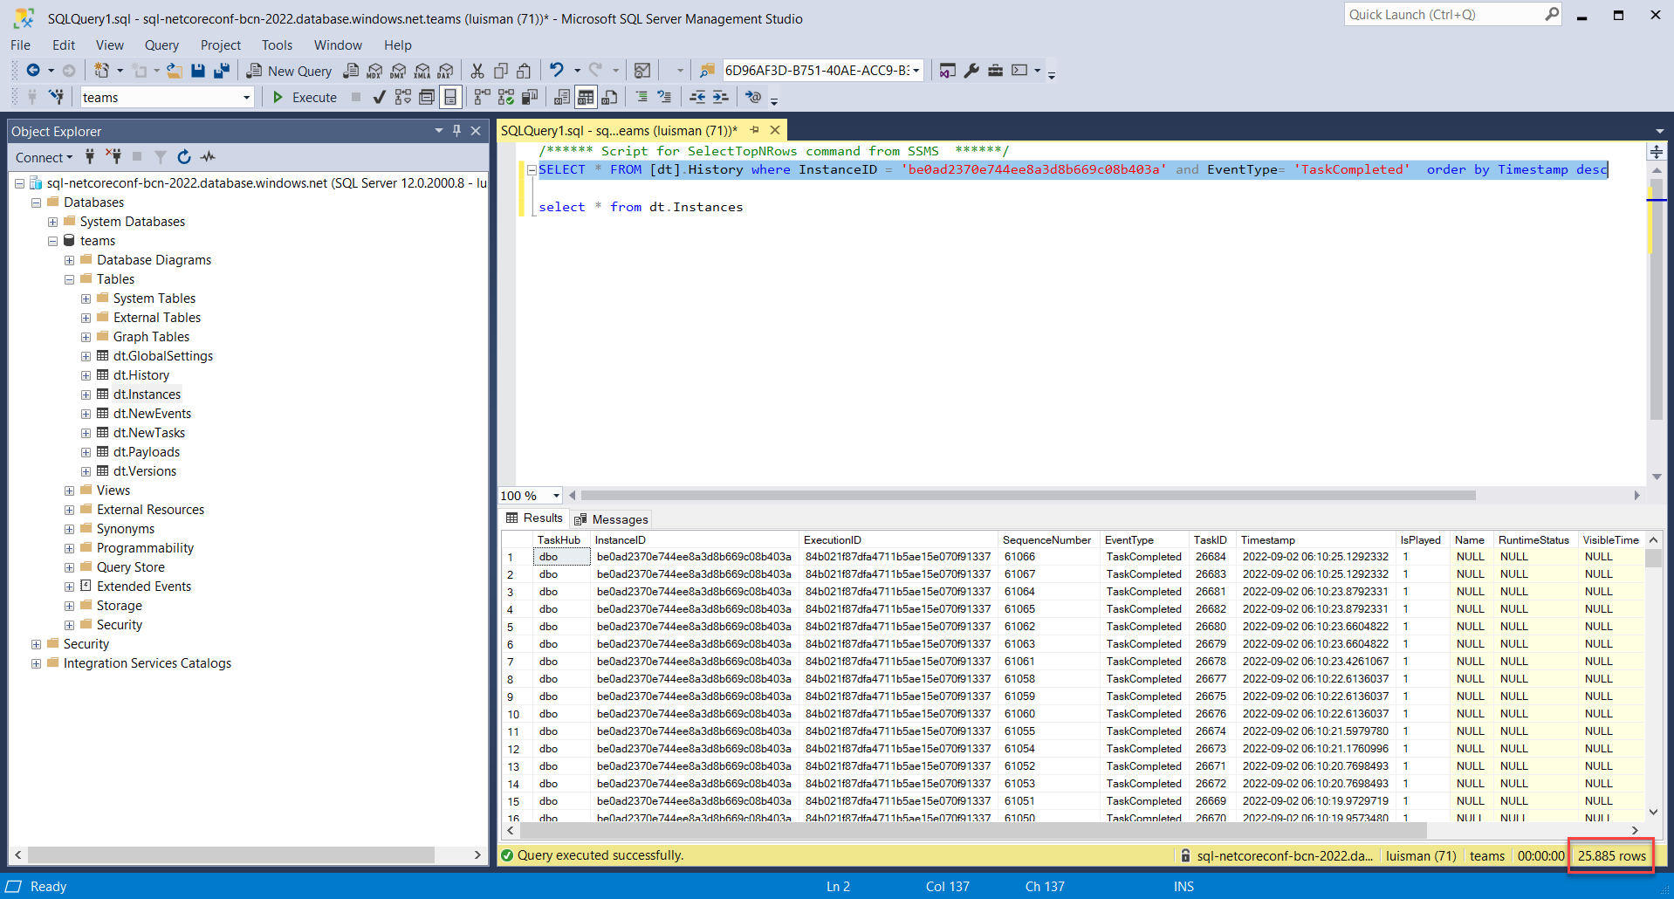
MS SQL Server - Processing 30k items (Azure App Service P1V2)
Orchestrator Stuck!!
After Processing during more than 27 hours
25,885 Items processed

Slide 19
Let´s dive in!
Durable Function with Netherite Storage Provider

Slide 20
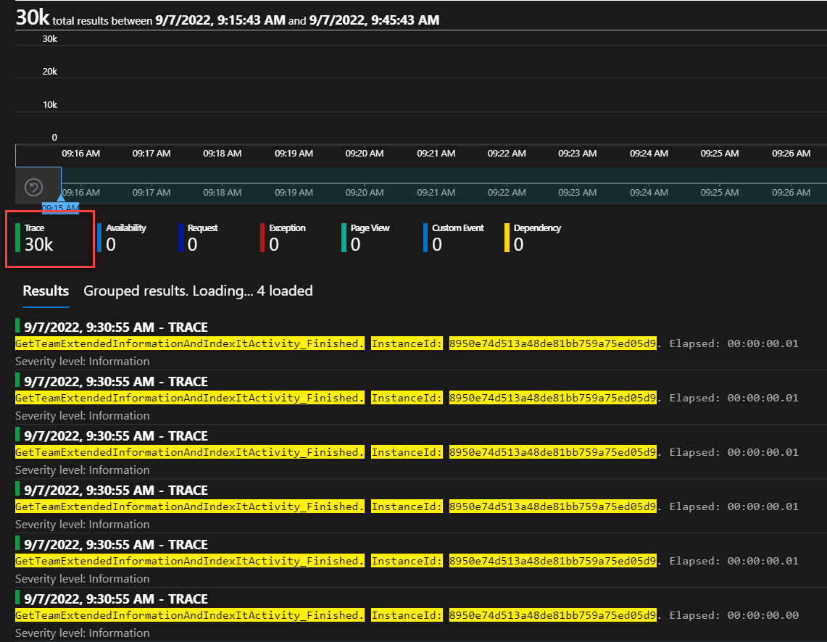
Netherite - Processing 30k items (Azure Elastic Plan P3)

Slide 21
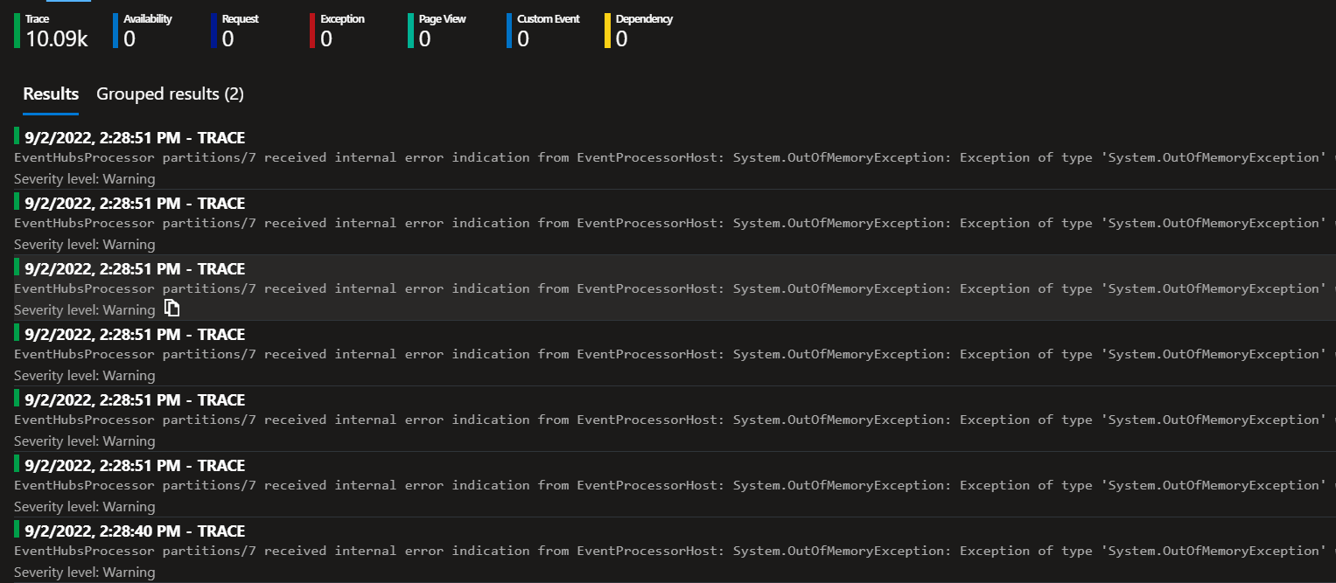
Netherite - Processing 30k items (Azure Elastic Plan P3)

Slide 22
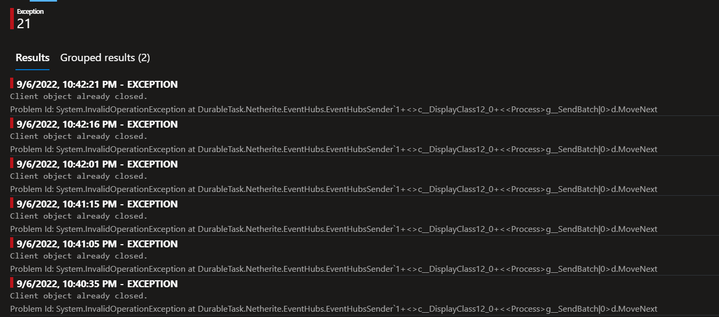
Netherite - Processing 30k items (Azure Elastic Plan P3)

Slide 23

Performance Benchmarks
Storage Provider | 500 items | 30.000 items
Azure Storage | 2'45"
MS SQL Server | 1'49"
Netherite | 0'25"

Slide 24
NOW
WHAT?

Slide 25
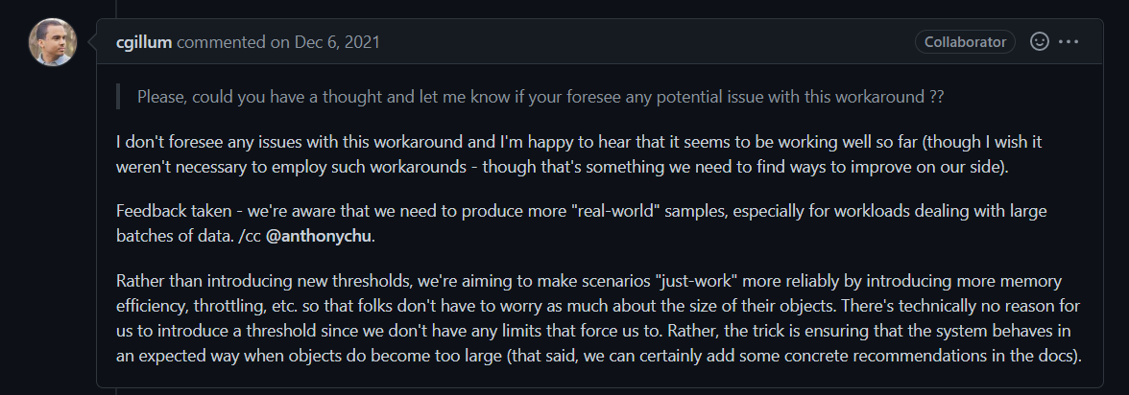
https://github.com/Azure/azure-functions-durable-extension/issues/2020

Slide 26
Rather than introducing new thresholds, we're aiming to make scenarios "just-work" more reliably by introducing more memory efficiency, throttling, etc. so that folks don't have to worry as much about the size of their objects. There's technically no reason for us to introduce a threshold since we don't have any limits that force us to. Rather, the trick is ensuring that the system behaves in an expected way when objects do become too large (that said, we can certainly add some concrete recommendations in the docs).

Slide 27
Common Pitfalls with Durable Functions
Code constraints
Idempotency
Versioning
Payload sizes
History log sizes
Dead-lettering or poison-message handling
https://medium.com/@cgillum/common-pitfalls-with-durable-execution-frameworks-like-durable-functions-or-temporal-eaf635d4a8bb

Slide 28
https://github.com/luismanez/netcoreconf-bcn-2022

Slide 29
References
Durable Functions Official Docs
Durable Functions Storage Providers
Durable Task SQL Provider (microsoft.github.io)
Netherite Workflow Execution Engine (microsoft.github.io)
Orchestrator stuck when processing High volume data (with source code to reproduce it) · Issue #2020 · Azure/azure-functions-durable-extension (github.com)
Common Pitfalls with Durable Execution Frameworks, like Durable Functions or Temporal | by Chris Gillum | Aug, 2022 | Medium

Slide 31
More information:
info@netcoreconf.com
@Netcoreconf
Visit on:
netcoreconf.com
Thanks

